Slide 1




WEB PAGES DESIGN
Links and Images
Lecturer: Dr. Atheer Akram AbdulRazzaq
Lecture 8.
Class 2.
Time: 10:30 - 12:30
Department: Businesses Information Technology (BIT)

Slide 2
Outline
Outline
a Element
Relative URLs
index.html File
Web Design
Navigation Within a Web Page
CSS for Links
a Element Additional Details
Bitmap Image Formats: GIF, JPEG, PNG
img Element
Vector Graphics
Responsive Images
Summary

Slide 3
Outline
a Element
To implement a link, you’ll need to use the a element. Here’s an example a element that implements a link to (UOITC) University of Information Technology and Communication website:
<a href="http://www.uoitc.edu.iq">UOITC</a>
The text that appears between an a element’s start tag and end tag forms the link label that the user sees and clicks on. By default, browsers display link labels “UOITC” with underlines. So this code renders like this:
UOITC
The blue color indicates that the linked-to page has not been visited. When the user clicks on a link, the browser loads the resource specified by the href attribute.
For this example, the “resource” is another web page, so when the user clicks on the “UOITC” link, the browser loads that web page—the one at http://www. uoitc.edu.iq.
Besides enabling a user to load a resource, the a element can be used as a mechanism that enables a user to download a file of any type—image file, video file, PDF file, Microsoft Word file, and so on.

Slide 4
Outline
a Element (continue…)
To implement that download functionality, include a download attribute as shown here:
<a download href=“http://www.park.edu/catalogs/catalog2018-2019.pdf”> Park University 2018-2019 catalog</a>
As always for the a element, the browser displays the text that appears between the start tag and end tag; in this case, that’s “Park University 2018–2019 catalog.” When the user clicks on that text, the browser downloads the file specified by the href attribute.
The user can then choose to view it or save it. Normally, the download attribute has no value, but if you want the end user to save the file using a different filename than that specified by the href atttibute, then you should include a filename for the download attribute’s value, such as download="Park University 2018-2019 catalog.pdf".
Continuation Rule for Elements that Span Multiple Lines
The a element is a phrasing element (which means that it displays “inline,” like a phrase within a paragraph). Most phrasing element code is short and can easily fit on one line, but the preceding a element is rather long and spans two lines.

Slide 5
Outline
a Element (continue…)
Continuation Rule for Elements that Span Multiple Lines (continue…)
The solution was to press enter at the end of the a element’s start tag and indent the next line. We use that same solution for other elements that are too long to fit on one line. Here’s a meta element example:
<meta name="description’’
content="This web page presents Dean family highlights.">
Note that we press enter after the name attribute-value pair. In the a element example, we pressed enter after the a element’s start tag. The goal is to press enter at a reasonable breaking point.
For the preceding example, if we wait to press enter until after “Dean family,” that would not be a “reasonable breaking point.” It would split the content attribute’s value across two lines. The p element is a block element, and here’s a properly formatted p element:
<p>
Known for its Computer Science program,
<a href="http: //www.park.edu/ informationAndComputerScience /accolades"> Park University</a> is tied for first in the number of Sciences and Technology Award winners among all city universities.
</p>
Press enter.
Align the a element’s continuation line with the prior line.

Slide 6
Outline
a Element (continue…)
Continuation Rule for Elements that Span Multiple Lines (continue…)
Within the p container, there’s an a element that spans more than one line, and we align its continuation line with the line above it. That’s different from the prior a element example.
Note the line break in the source code after “program,”. We inserted a line break so we could fit the a element’s entire start tag on one line. If we attempt to put the a element’s entire start tag on the same line as “program,” then line wrap would occur if we printed the code on paper. Here’s what that would look like:
<p>
Known for its Computer Science program, <a
href="http: //www.park.edu/ informationAndComputerScience /accolades"> Park University</a> is tied for first in the number of Sciences and Technology Award winners among all city universities.
</p>
Note how href wraps to the next line where it’s not indented. The href is aligned with the <p> start tag, and that implies that href is separate from the p element rather than a part of it.
line wrap

Slide 7
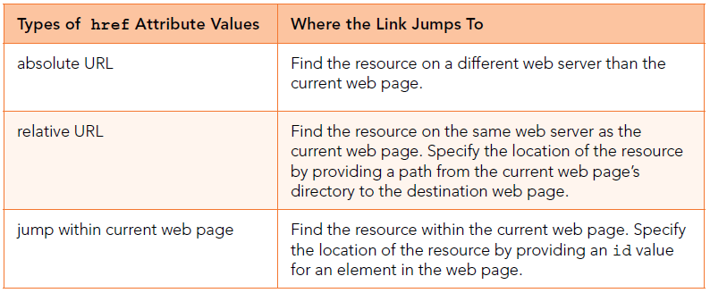
Outline
a Element (continue…)
Different Types of href Values
As we know, the a element’s href attribute value specifies the resource that is to be loaded. In addition to specifying the resource, the href attribute value indicates where the link jumps to in order to find the resource.
Figure1., provides an overview of the different link-jumping techniques employed by the href attribute’s value.
For an example that uses an absolute URL, suppose you want to add a link on a Facebook page that directs the user to an Instagram page. Here’s the link code to do that for a subscriber named
Ahmed Ali:
<a href=" https://www.instagram.com/AhmedAli.html">
Ahmed's Instagram</a>
Figure 1. href attribute values

Slide 8
Outline
a Element (continue…)
Different Types of href Values (continue…)
Note the https value for the href attribute. You’ve seen http in the past; https is another popular protocol that you can use with the href attribute. It stands for hypertext transfer protocol secure. So the https protocol provides more security for communications than does http.
Relative URLs
A relative URL value allows you to jump to a web page that resides on the same web server as the current web page. It does so by specifying a path from the current directory to the destination web page.
The current directory is the directory where the current web page resides. The destination web page is the page that the user jumps to after clicking on the link.
Note the example directory tree in Figure2., It shows the container relationships between all the files and directories that are within the oleung directory. The oleung directory is the home page directory for student Olivia Leung. A home page is the default first page a user sees when the user visits a website.
A subdirectory (also called a subfolder or a child folder) is a directory that is contained within another directory. Thus, in Figure 2., there are four subdirectories within oleung home page directory and one subdirectory within misc subdirectory.

Slide 9
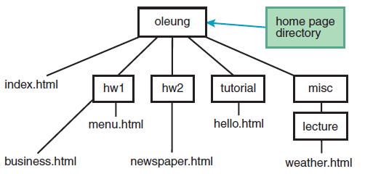
Outline
Relative URLs (continue…)
The index.html file is in the oleung directory, and the other files are in the tree’s subdirectories. Because oleung is the home page directory, index.html is the home page file.
In forming a path for a relative URL value, you’ll need to navigate between a starting directory and a target file. In doing so, you’ll need to follow these rules:
Use /’s to separate directories and files.
Use “..” to go from a directory to the directory’s parent directory.
In Figure 2., oleung is the parent directory of hw1 because oleung and hw1 are connected by a single line with oleung on the top.
Figure 2. Example directory tree

Slide 10
Outline
Relative URLs (continue…)
The point of all this is that if you’re in a directory and you want to go to that directory’s parent directory, you need to use .. For example, suppose you want to provide a link on the newspaper page that takes a user to the home page, index.html.
Because the newspaper page is in the hw2 directory, the hw2 directory is considered to be the current directory. The home page is in the oleung directory. The oleung directory is the parent directory of hw2, so you need to use .. in order to navigate up to the oleung directory. Here’s the relevant a element code:
<a href="../index.html">Olivia's Home Page</a>
Relative Path Examples
Assuming you’ve tried to work it out on your own, now you may look at the answer:
<a href="hw1/business.html">Business Page</a>
If you’re in a web page, then you’re already in that web page’s directory. So to go from the index.html page to the business page, you simply go down from oleung to hw1 by specifying hw1, then down to the business page by specifying /business.html.
The index.html page is the website’s home page, and as such, it’s the first page that you look at when you visit a website. To help with a user’s viewing experience, home pages should normally contain links to other pages on the website.

Slide 11
Outline
Relative URLs (continue…)
Relative Path Examples (continue…)
Assuming you’ve made an honest attempt, now you can look at the answer:
<a href="misc/lecture/weather.html">Weather Page</a>
Because the link resides on the home page, the path originates from the home page directory, oleung. To get to the weather page, you have to go down to the misc directory and then down to the lecture directory. In the example code, notice the /’s separating the two directories and the weather.html filename.
As an alternative, you can have the relative URL’s path start at the web server’s root directory. A web server’s root directory is the directory on the web server that contains all the directories and files that are considered to be part of the web server. If you want to have the relative URL’s path start at the web server’s root directory, preface the URL value with /.
For example, using Figure 2., directory tree, if oleung is immediately below the web server’s root directory, the following code could be added to any of the web pages shown, and it would implement a link to the index.html page:
<a href="/oleung/index.html">Olivia's Website</a>
A URL value that starts with a / is referred to as a path-absolute URL, and it’s a special type of relative URL (it’s considered a relative URL because the path is relative to the current web server’s root directory).

Slide 12
Outline
index.html File
If a user specifies a URL address that ends with a directory name, then the web server will automatically look for a file named index.html or index.htm and attempt to load it into a browser. This occurs when you specify a URL for a link’s href value and also when you enter a URL in a web browser’s address box.
The default searched-for file can be reconfigured by the web server’s administrator. It’s common for Microsoft IIS (Internet Information Services) web server administrators to use default.htm as another default filename for displaying a web page when the URL address ends with a directory name.
The recommendation to use index.html for your home page file names because that name is the most standard. We prefer .html to .htm because .html is more descriptive—after all, “html” describes the code contained in the file.
If a user specifies a URL address that ends with a directory name, and the web server cannot find a file named index.html or index.htm (or possibly default.htm) in the specified directory, then the web server will either (1) load a web page that shows the contents of the specified directory, or (2) display an error page (e.g., “Directory Listing Denied” or “HTTP 404 – Page Not Found”).
To avoid the directory contents web page (which is rather ugly) or the error page, you should include an index.html file in every directory that might be specified as part of a URL.

Slide 13
Outline
Web Design
There are a tips on how to make a good first impression. These tips are part of a software area known as web design, which is comprised of these subareas: user interface design, user experience design, graphic design, and search engine optimization. We do explain the surface on user interface design and user experience design.
User Interface Design
User interface design (UID) refers to the mechanisms by which users of a product can use the product. For web pages, the mechanisms are things like text, color, pictures, buttons, text boxes, and progress bars.
A good UID designer will anticipate users’ needs and create an interface that meets those needs by incorporating components that are easy to understand and use.
After the home page downloads, users will want to identify the web page’s main content quickly. To help in that regard, you should try to avoid clutter, and focus on clear, concise words (and graphics, if appropriate) that describe the web page’s main content.
The home page is only for the main content and links to other web pages, not for lots of details.
If you need to provide lots of details for something, you should put those details on a separate web page and link to that page from the home page.
In presenting the web page’s content, it’s important to be consistent with your text and colors.

Slide 14
Outline
Web Design (continue…)
User Experience Design
The user experience might be a feeling of calm comfortable control. For a web page, the UID incorporates the elements described in the previous subsection, whereas the user experience design is the feeling produced by those UID elements.
For example, you should choose colors and fonts that generate the proper feeling for the user’s browsing experience.
The user experience design’s feeling comes not only from UID elements, but also from things that enhance the user’s ability to digest the web page’s content, such as helpful pictures, familiar controls, fast downloads, and efficient navigation between web pages.
The first thing a web user notices when visiting a web page is how long it takes to load the page.
In particular, image files and video files tend to be large.
But for a positive user experience, you should still try to avoid having your home page built with large files.
Most home pages will have links to other web pages within the website. You should use the nav container to group those links. Normally, users navigate to other web pages by clicking links at the top and left, so that’s where your nav containers should go. Suppose your website has lots of web pages.

Slide 15

Outline
Web Design (continue…)
User Experience Design (continue…)
See Figure 3., which shows the organization for a website whose pages are organized with a linear structure. That means the home page links to one other page, and that second page links to one other page, and so on.
That type of strategy might be used for a website whose purpose is to present a long article. By splitting up the article into separate pages and connecting them with links, the user doesn’t have to scroll so far down while reading.
Another example, where a linear structure is beneficial are a shopping cart that steps through the transaction or a tutorial with a specific sequence of steps.
Now take a look at Figure 4., which shows a website whose pages are organized with a hierarchical structure. That means the home page links to several other pages where those pages serve as pseudo-home pages for different areas within website.
When compared to linear structure websites, hierarchical structure websites tend to reduce the number of clicks needed to navigate through a website’s web pages.
With hierarchical structures, the home page is often called the top-level page, and the nextlevel pages are often called second-level pages.
Figure 3. Website with a linear structure for its web pages

Slide 16
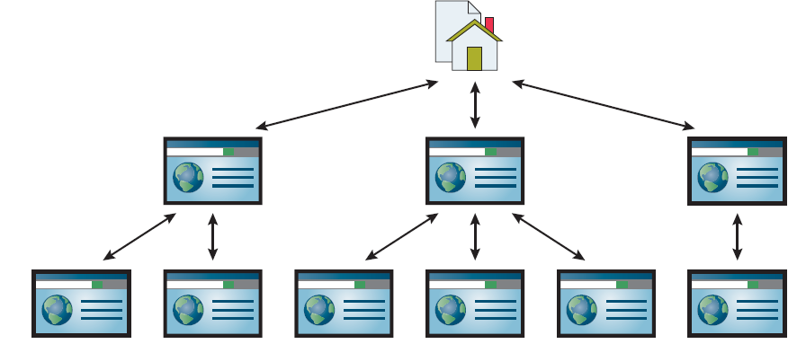
Outline
Web Design (continue…)
User Experience Design (continue…)
Second-level pages have links to the other pages in their areas. Both top-level and second-level pages are sometimes referred to as landing pages because they can be targets (or “landing places”) of links that reside outside the website.
Finally, take a look at Figure 5., which shows a website whose pages are organized with a mixed structure. There’s a hierarchical structure for compartmentalizing the website’s main areas, plus additional links that (1) connect from within the areas to other areas and (2) connect pages back to the website’s home page.
For good websites, this sort of mixed structure is by far the most common type of structure because it leads to the best user experience—fewer clicks to drill down to different pages within a given area and fewer clicks to jump from within one area to get to a different area.
Figure 4. Website with a hierarchical structure for its web pages

Slide 17
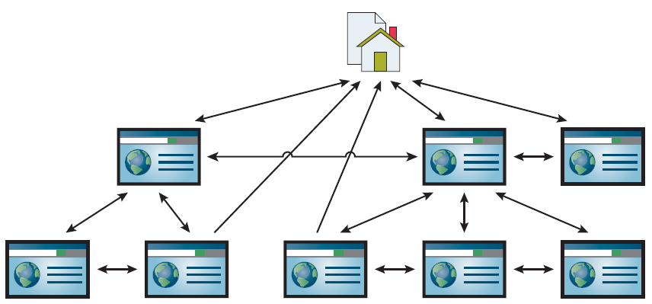
Outline
Web Design (continue…)
User Experience Design (continue…)
.
Navigation Within a Web Page
We’ve already talked about an absolute URL value and a relative URL value. In both of those cases, the target is a web page separate from the current web page. The third type of href value shown in Figure 1., is for when you want a link that takes the user to some specified point within the current web page. That can be particularly useful for long web pages, so the user can quickly jump to designated destinations within the web page.
Figure 5. Website with a mixed structure for its web pages

Slide 18
Navigation Within a Web Page (continue…)
Outline
For example, note the blue links near the top of the Clock Tower web page in example1., If the user clicks the Clock Tower Photograph link then the web page scrolls within the browser window so that the link’s target gets positioned at the top of the browser window.
In example 1., there is no scroll bar, so no scrolling takes place if the link is clicked. If a web page has internal links, then the web page will normally be sufficiently long so as to justify the internal links.
Note the Back to the Top link at the bottom of the page. With a long web page, it’s common to have such a link so the user can quickly get back to the top after scrolling to the bottom. Once again, because there is no scroll bar in example 1., browser window, no scrolling takes place if the link is clicked.
Syntax for Internal Link
In the Clock Tower web page in example 1., to jump to a designated location within the current web page, you need to use a value starting with # such that that value matches an id attribute’s value for an element in the web page.
Here’s the Clock Tower web page’s code that links to the pledge drive section:
<a href="#pledge-drive">Pledge Drive</a>
And here’s the element that that link jumps to:
<h3 id="pledge-drive">Pledge Drive</h3>

Slide 19
Navigation Within a Web Page (continue…)
Outline
Syntax for Internal Link
For a given web page, you can have only one element with a particular id value. So because pledge-drive appears in this h3 statement, pledge-drive cannot be used as an id value anywhere else within the Clock Tower web page.
If another element used that same id value, then the browser engine would be confused as to which target element to link to when the user clicks the a element (with href="#pledge-drive") shown.
Note: &nbsp;. A non-breaking space is a space that will not break into a new line.
Example 1A.
<body>
<header>
<h1 id="top">Park University's Clock Tower</h1>
<h5>
<a href="#tower-photo">Clock Tower Photograph</a>&nbsp; | &nbsp;
<a href="#pledge-drive">Pledge Drive</a>
</h5>
</header>
<div class="table">
<nav class="cell">
<div class="nav-heading">Other Park History</div>
<div><a>Swimming Pool</a></div>
<div><a>The Main Park</a></div>
<div><a>Old Kate</a></div>
<div><a>The Old Well</a></div>
</nav>
It's common to use a
vertical bar to separate
internal links.
Note the character references to ensure two spaces on each side of the vertical bar.

Slide 20
Navigation Within a Web Page (continue…)
Outline
Example 1A. (continue…)
<section class="cell">
<p>
The clock tower has a long and storied history. Built in 800 A.D. by the ancient Parkite Indian tribe, it was originally used as a beacon for parties. In 1865, because of its extraordinary time-keeping accuracy, it served as the world's first Coordinated Universal Time clock.
</p>
<p>
<img id="tower-photo" src="../Athweb/clock-tower.jpg"
alt="Clock Tower Photograph">
</p>
<h3 id="pledge-drive">Pledge Drive</h3>
<p>
The clock tower building is crumbling. Park needs your support. Do it for the kids. Send cash contributions to R.W@park.edu.
</p>
<a href="#top">^ Back to the Top</a>
</section>
</div>
</body>
</html>

Slide 21
Navigation Within a Web Page (continue…)
Outline
Walking Through the Clock Tower Web Page’s Source Code
The Clock Tower web page’s code is long, requiring two parts in the example to show it all. example 1A. shows the web page’s body container, and example 1B. shows the head container.
In the body container code that separates the tower-photo and pledge-drive links:
&nbsp; | &nbsp;
Using a vertical bar (|) to separate internal links is a very common technique.
Note the &nbsp; character references and the blank spaces surrounding the vertical bar. By inserting a &nbsp; character reference next to a space character at the left of the vertical bar and also at the right of the vertical bar, that causes two spaces to display on each side of the vertical bar, which looks nicer than single spaces.
We’re using a simple CSS table for layout with only one row and two cells—one cell for the navigation bar at the left and one cell for the web page’s main content.
In the Clock Tower nav container, note the a elements and the fact that they have no href attributes. An a element that has no href attribute is called a placeholder link.
The nav and section elements both contain class="cell" attribute-value pairs.

Slide 22
Navigation Within a Web Page (continue…)
Outline
Clock Tower Web Page’s CSS Rules
Note the .table and .cell selectors in example 1B., note that there is no .row selector. For a browser to render a table, the cells need to be inside rows, so how can there be no .row selector that implements the rows? if you have table-cell elements that are not surrounded by a table-row element (or even a table element), then the browser engine generates an anonymous (hidden) table-row element around those table-cell elements.
Here’s the relevant code from example 1A.:
<div class="table">
<nav class="cell">
...
<section class="cell">
...
</div>
Here’s the CSS rule for the navigation area’s cell:
nav.cell {width: 80px;}
You’ll see that cell appears as a class attribute value in two places—in the nav container (which implements the navigation bar at the left) and also in the section container (which holds the page’s main content).The nav.cell selector matches only the cell in the navigation area at the left. And after matching that navigation area cell, it specifies a fixed width for it.
Anonymous table-row
element start tag goes here.
Anonymous table-row
element end tag goes here.

Slide 23
Navigation Within a Web Page (continue…)
Outline
Clock Tower Web Page’s CSS Rules
Note In the following CSS rule, the table-cell value for the display property. Now let’s talk about its padding property:
.cell {
display: table-cell;
padding: 0px 10px 10px;
}
The padding specifies that there’s no padding on the top, 10 pixels of padding on the left and right (from the second value), and 10 pixels at the bottom.
It also requires setting no margin above each of the top elements in the navigation bar cell and the main content area cell. Here’s the relevant CSS rule from the Clock Tower web page’s code:
.cell > :nth-child(1) {margin-top: 0;}
The :nth-child() selector is a special child selector in that it allows you to specify which child element is selected. This particular rule selects immediate children of “cell” elements where the child is a first child (the 1 value is for the first child).
The :nth-child() selector thing is a pseudo-class. So behind the scenes, that rule converts to this rule:
.cell > *:nth-child(1) {margin-top: 0;}
The * universal selector matches all elements, so all elements are matched (that are children of elements with a class attribute value of cell) and the browser then applies the :nth-child(1) pseudo-class to those matches.

Slide 24
Navigation Within a Web Page (continue…)
Outline
Clock Tower Web Page’s CSS Rules
Example 1B.
<!DOCTYPE html>
<html lang="en">
<head>
<meta charset="utf-8">
<meta name="author" content=“AAA">
<title>Park University Clock Tower</title>
<style>
header {text-align: center;}
.table {display: table;}
.cell {
display: table-cell;
padding: 0px 10px 10px;}
nav.cell {width: 80px;}
/* Avoid yellow background at left extending above the page's main content. */
.cell > :nth-child(1) {margin-top: 0;}
nav {
color: darkred;
background-color: lemonchiffon;
}
.nav-heading {background-color: gold;}

Slide 25
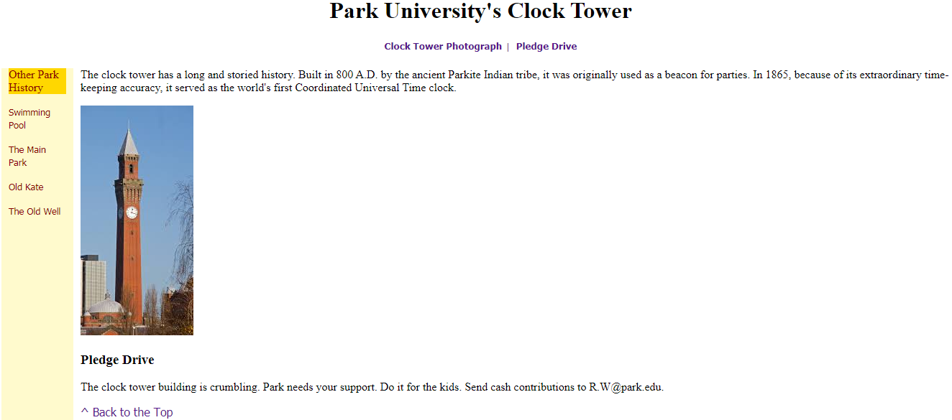
Navigation Within a Web Page (continue…)
Outline
Clock Tower Web Page’s CSS Rules
Example 1B. (continue…)
/* Adjust link appearances. */
a {
text-decoration: none;
font-family: Tahoma, Geneva, sans-serif;
}
a:hover {text-decoration: underline;}
nav a {font-size: .8em;}
nav > * {margin: 1em 0;}
</style>
</head>
Output:

Slide 26
CSS for Links
Outline
The Clock Tower web page in example 1., the left link, labeled Clock Tower Photograph, is blue, indicating that the link has not been clicked. On the other hand, the right link, labeled Clock Tower Photograph, is purple, indicating that the link has been clicked in the past.
A link is defined as a “visited link” if it leads to a location that the computer’s browser has been to recently.
Browsers have different time limits to determine whether a location has been visited “recently.” If you clear your browser’s history, the browser will consider all links to be unvisited, so they will go back to their unvisited color.
You can use CSS to override the link colors specified by the browser, and those CSS rules override the user’s link color browser settings as well.
Now for the CSS that enables you to specify link colors. For unvisited links, use this syntax:
a:link {color: color-value;}
The a is the element type for a link element. The :link thing is a pseudo-class. It qualifies the a element type by searching only for links that have not been visited. As you’d expect, the a:link selector is known as a pseudo-class selector.
You now know to use a:link for unvisited links. For visited links, use a:visited, like this:
a:visited {color: color-value;}

Slide 27
CSS for Links (continue…)
Outline
The first rule specifies burlywood for unvisited links, and the second rule specifies light blue for visited links:
a:link {color: burlywood;}
a:visited {color: #aaaaff;}
In addition to being able to change the colors in your web page’s links, you can also change your links’ underline scheme. By default, browsers display links with underlines. If that leads to visual clutter or confusion with regular text that’s underlined, and you’d like to have no link underlining, then use text-decoration: none, like this:
a {text-decoration: none;}
If link underlines are disabled using this CSS rule, but you want to display underlines when the mouse hovers over a link, use the a:hover pseudo-class selector with text-decoration: underline, like this:
a:hover {text-decoration: underline;}
Also note the two nav element CSS rules, which are copied here for your
convenience:
nav a {font-size: .8em;}
nav > * {margin: 1em 0;}

Slide 28
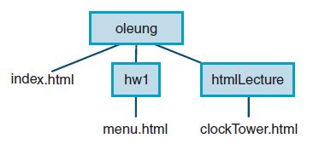
a Element Additional Details
Outline
Linking to a Specified Location Within a Different Web Page
To link to a specified location within a different web page, use the href attribute to specify the other page (using an absolute url with http or a relative URL) and then append a # value to specify the location within that page.
Given the following directory tree, can you provide a link from the home page to the clock tower photograph?
The photograph’s img element resides in the clockTower.html web page, and it uses an id value of tower-photo.
student Olivia Leung has an index.html home page in her oleung home page directory. In implementing a link from the home page to the clock tower photograph, first go up to the oleung home directory.
So the path to the clock tower photograph starts by going down (from the oleung directory) to the htmlLecture directory. Here’s the link code:
<a href="htmlLecture/clockTower.html#tower-photo">
Park University Clock Tower Photograph</a>

Slide 29
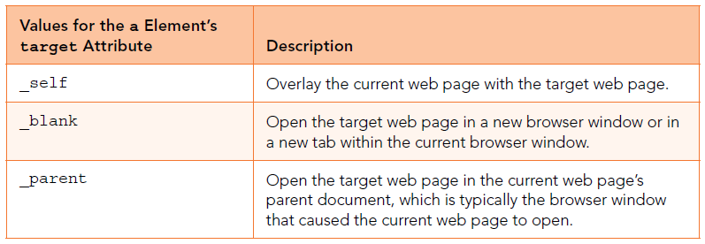
a Element Additional Details (continue…)
Outline
target Attribute
The a element’s target attribute value specifies where to open the linked-to web page. Note the three values listed in Figure 6.
The target attribute's default value is _self. As noted in the figure, if you have a link that uses the _self value and the link is clicked, the specified new page loads within the current web browser and overlays the previous page.
If you have a link that uses the _blank value and the link is clicked, the specified new page loads in a new browser window or in a new tab within the current browser window.
Here’s an example link element that uses the _blank value:
<a href="https://www.youtube.com/watch?v=zm48WoRs0hA&noredirect=1"
target="_blank">Bethany Mota: Perfect Back to School Hair, Makeup
&amp; Outfit!</a>
If you have a link that uses the _parent value and the link is clicked, the target web page loads in the current web page’s parent document, which is typically the browser window that caused the current web page to open.
Effectively, that means if you use target="_blank" to open a web page in to a new window or new tab, you can use target="_parent" to open another web page in the original window or tab.
Figure 6. Specifying the environment in which the web page opens

Slide 30
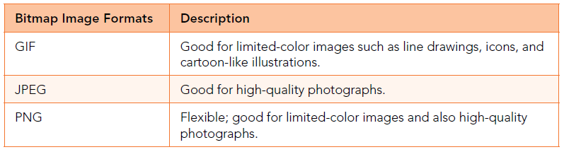
Bitmap Image Formats: GIF, JPEG, PNG
Outline
There are two basic categories of image files—bitmap image files and vector graphics files. For example, an icon, which is simply a small image file, typically has 16 rows with 16 pixels in each row. Within a bitmap image file, every pixel gets mapped to a particular color value, and each color value is a sequence of bits (where a bit is a 0 or a 1). For a browser to display a bitmap image, it displays each pixel’s mapped color.
The three most common formats for bitmap image files (also called raster image files) on the Web are GIF, JPEG, and PNG.
You should be aware of two other file formats—BMP (for bitmap) and TIFF (for tagged image file format). They’re both very popular for graphics applications, but they’re generally not used with web pages.
GIF Image File Format
GIF stands for Graphics Interchange Format, Image file formats with GIF files. GIF files use a filename extension of .gif. In creating a GIF file from an original picture, the original picture’s colors are mapped to an 8-bit palette of colors. That means each pixel uses 8 bits, and those 8 bits determine the pixel’s color.
Figure7. Common formats for web page bitmap image files

Slide 31
Bitmap Image Formats: GIF, JPEG, PNG (continue…)
Outline
GIF Image File Format (continue…)
And the entire set of colors forms the image’s color palette. Each image has its own color palette with its own set of colors such as (red, brown, and blue). With 8 bits for each color value, there are 256 different ways to arrange the 0’s and 1’s.
GIF file image being a degraded version of the original photograph. Color degradation is nonexistent or imperceptible for limited-color images such as line drawings, icons, or cartoon-like illustrations, GIF files are good for those types of things and not good for color photographs.
JPEG Image File Format
The JPEG image file format. JPEG stands for Joint Photographic Experts Group, JPEG files use a filename extension of .jpeg or .jpg.
In creating a JPEG file from an original picture, the original picture’s colors are mapped to a 24-bit palette of colors. With 24 bits, there are approximately 16 million permutations of 0’s and 1’s in each color value.
That means approximately 16 million unique colors can be represented, and that’s more colors than the human eye can discern. So unless you’re an eagle with the ability to distinguish between more than 16,000,000 colors, you should be in good shape with the quality of colors in JPEG files.
The person who creates the JPEG image file chooses the lossiness of the compression scheme—higher loss means greater color degradation and greater file size reduction. Nonetheless, for photographs, optimized JPEG files almost always produce a better balance between file size and quality than the other file formats.

Slide 32
Bitmap Image Formats: GIF, JPEG, PNG (continue…)
Outline
PNG Image File Format
PNG stands for Portable Network Graphics, files use a filename extension of .png.
The PNG format provides more flexibility in terms of clarity versus file size. In creating a PNG file from an original picture, you can choose to map each pixel to only a few bits all the way up to 64 bits per pixel.
The additional bits for 64-bits-per-pixel PNG files are for things like multiple channels and opacity/transparency levels.
The PNG format provides more flexibility in terms of transparency. You can create images with different levels of transparency for different parts of an image. GIF images can have only two levels of transparency—completely opaque or completely transparent.
img Element
In this section, we’ll review what you learned and provide more details. Let’s jump right into an img element example:
<img src="../images/winkingSmiley.gif"
alt="Winking Smiley Face" width="50" height="50">
The src attribute specifies the image’s filename and the location of the image’s file. In this img element, the filename is winkingSmiley.gif. The location is indicated by the path that comes before the filename.
The path that comes before winkingSmiley.gif is ../images/.
How would you specify src’s value if winkingSmiley.gif was in the same directory as the current web page? The answer is.. src="winkingSmiley.gif". The key is to realize that if the image file and current web page are in the same directory, then there’s no need for a path.

Slide 33
img Element (continue…)
Outline
If you omit the img element’s width and height attributes, then the image will display with its natural size, which is a good thing. But specifying its natural size explicitly is better because that improves download speed?.
The size and position of the image affects the layout of the other items on the web page.
For example, the width of an image determines whether the subsequent item on the web page gets positioned at the right of the image or on the next row.
If the image’s dimensions are known early during the web page download process, then those dimensions can be used to display the web page’s other items in their proper positions. On the other hand, if the image’s dimensions are not specified, then the browser has to wait for the image file to be downloaded and displayed before it knows where to position the other items.

Slide 34
Responsive Images
Outline
Responsive web design (RWD) is the practice of writing code that dynamically generates web pages that conform to different screen sizes and viewing orientations (portrait or landscape).
We’ll describe how to implement responsive images using the resolution switching technique and the art direction technique.
Resolution Switching
Resolution switching is when you provide a list of images for different versions of the same picture where the images are identical in terms of aspect ratio, where aspect ratio is the ratio of an image’s width to height.
In example 4.,there is the img element for a web page that employs resolution switching to display one of three different pictures on a web page.
Note the srcset attribute, which provides a comma-separated list of image filenames with an image width next to each filename.
Note the sizes attribute. Its value helps the browser choose the most appropriate file from among the srcset attribute’s list of image files. The sizes attribute provides a comma-separated list of values. Each value has two parts—a condition that checks the width of the browser window’s viewport and the width of the slot in which the image displays.
The viewport is the area below the address bar where web page content displays. As you can imagine, mobile devices have the smallest viewports, whereas laptops and desktop monitors have the largest viewports.
The max width: 340px condition means that if the device’s viewport is less than or equal to 340 pixels, then the web page uses 90vw for its image slot width.
The 90vw value means that the image slot width spans 90% of the viewport’s width.

Slide 35
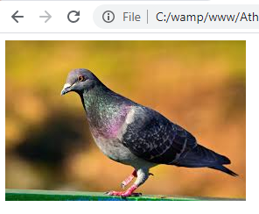
Responsive Images (continue…)
Outline
Example 4.
<img
srcset="pigeons-320w.jpg 320w,
pigeons-480w.jpg 480w,
pigeons-800w.jpg 800w"
sizes="(max-width: 340px) 90vw,
(max-width: 500px) 90vw,
800px"
src="pigeons-800w.jpg" alt="feeding pigeons in city center">
Output:
Art Direction
For both resolution switching and art direction, you provide a list of images for different versions of the same picture. With resolution switching, the different versions are different sizes, but they have the same aspect ratio. On the other hand, with art direction, the different versions can have different aspect ratios as a result of cropping the original picture in different ways.
The srcset attribute holds the image
filenames and their widths.
The sizes attribute holds viewport width
conditions and associated image-slot widths.

Slide 36
Responsive Images (continue…)
Outline
Art Direction (continue…)
For example, for a desktop computer layout, the browser’s viewport would be wider, so having a wide landscape-oriented picture should be OK. But for a mobile device layout, the browser’s viewport would be narrower, so using that same landscape-version image would probably make the picture’s main subject too small. The solution is to use a portrait-version image where the main subject can be zoomed in.
In example 5., The source element’s media attribute provides the condition that checks the viewport’s width, and the source element’s srcset attribute provides the image filename.
The first source element uses the condition max-width: 799px to check for a viewport width of less than or equal to 799 pixels. The second source element uses the condition max-width: 800px to check for a viewport width of greater than or equal to 800 pixels.
Example 5.
<!DOCTYPE html>
<html lang="en">
<head>
<meta charset="utf-8">
<meta name="author" content="AAA">
<title>Dominican Republic</title>
</head>
<body>
<h1>Joe Hartman School in the Dominican Republic</h1>

Slide 37
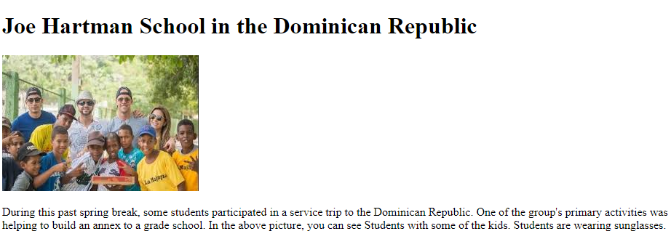
Responsive Images (continue…)
Outline
Art Direction
Example 5. (continue…)
<picture>
<source media="(max-width: 799px)" srcset="../Athweb/joe-450w.jpg.jpg">
<source media="(min-width: 800px)" srcset="../Athweb/joe-800w.jpg">
<img src="../Athweb/joe-800w.jpg" alt="students with kids at recess">
</picture>
<p>
During this past spring break, some students participated in a service trip to the Dominican Republic. One of the group's primary activities was helping to build an annex to a grade school. In the above picture, you can see Students with some of the kids. Students are wearing sunglasses.
</p>
</body>
</html>
Output:
The media attribute holds a viewport width condition.
The srcset attribute holds an image filename.

Slide 38
Outline
Summary
In this lecture we explain briefly the HTML <a> element with its href attribute, that creates a hyperlink to web pages, files, email addresses, locations in the same page, or anything else a URL can address.
We explained the A relative URL value, that allows us to jump to a web page that resides on the same web server as the current web page. It does so by specifying a path from the current directory to the destination web page.
Also we clarified the index. html a special file name which indicates that this was the default webpage for this directory of our website.
We learned a few tips on how to make a good first impression. These tips were part of a software area known as web design, which was comprised of subareas and we explained two of these areas that were user interface design and user experience design.
We described the Navigation Within a Web Page that was for when we wanted a link that takes the user to some specified point within the current web page.
Also in this lecture explained briefly the CSS for links including the meaning of visited links and unvisited links.
Also we highlighted Additional Details related to a Element which were combine to some of techniques and link to a specific location within a different web page.
In this lecture we explained a bitmap image format was a mapping from some domain to bits. Also clarified the three most common formats for bitmap image files on the Web which were GIF, JPEG, and PNG.
This lecture highlighted the description of img element details.
The final section in this lecture explained briefly the Responsive web design (RWD), which was the practice of writing code that dynamically generates web pages that conform to different screen sizes and viewing orientations (portrait or landscape).

Slide 39


THANK YOU

